Slide 1
Child and Dependent Care Credit
A non-refundable credit
Pub 4012 – Pages G-3 – G-5
Pub 4491 – Part 5 – Lesson 23
Notes:
Pub 17 – Chapter 32, Pages 211-217
Pub 4012 – G-3
Pub 4491 – Part 5
Resource Tool For Tax Counselors - Qualifying Child /Relative Tri Fold Laminate

Slide 2

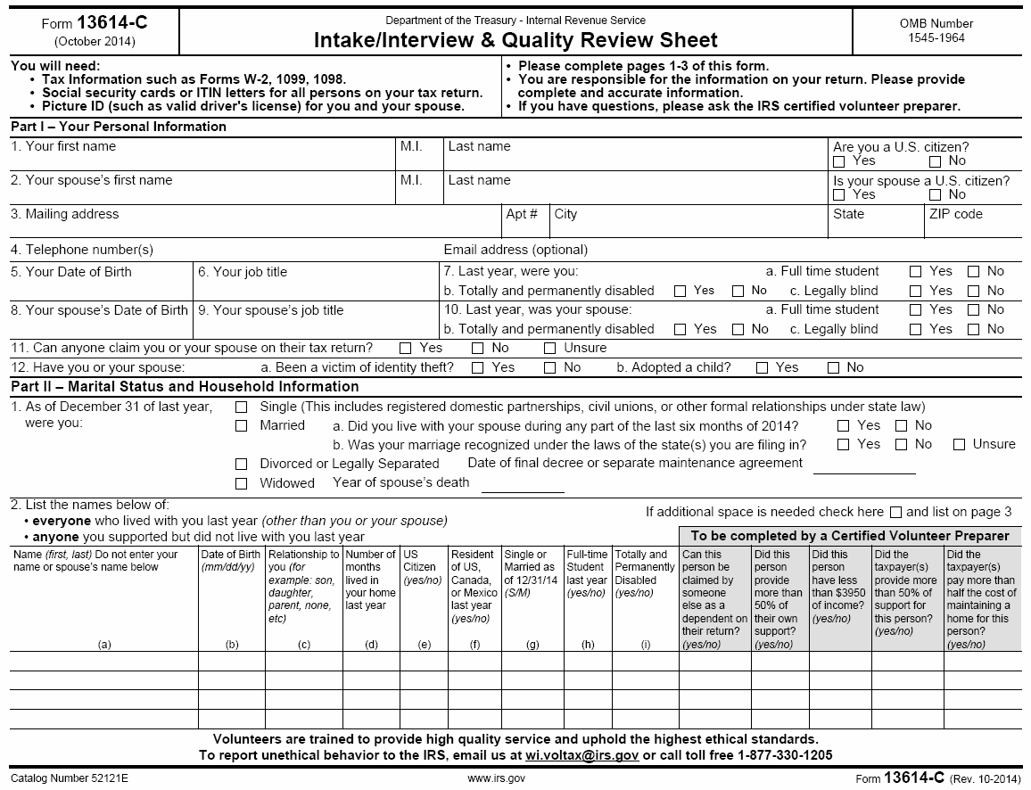
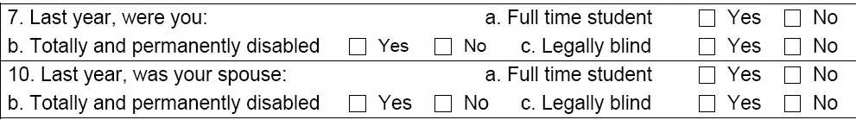
Taxpayer or Spouse Disabled?
Notes:
What are hints that this credit might be included?

Slide 3
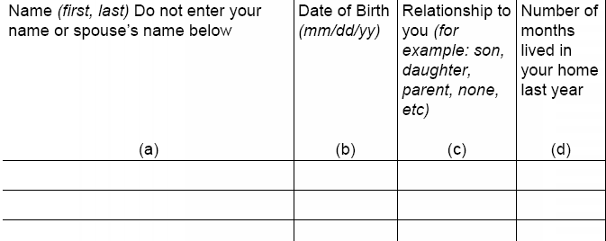
Any Dependents Under 13 or Disabled?
Notes:
Qualifying children under 13 qualify up until their 13th birthday – calculate partial year
If dependent is incapable of self care, qualify at any age
See: https://www.irs.gov/instructions/i2441/ar01.html#d0e71, also Pub. 501, Exemptions, Standard Deduction, and Filing Information

Slide 4
Dependent Care Expenses?
Did taxpayer or spouse pay for dependent care (or night care) while they worked or looked for work?
Notes:
Day care expense includes care for kids and for disabled adults
This person doesn’t have to be your dependent, so taxpayer may not mark the intake form correctly.
Ask if the caregiver is taxpayer’s employee—as opposed to an independent contractor. If so, and total payments were more than $2000, then Schedule H for household employees is required, and the return is out of scope.

Slide 5

Rules:
Care was for a qualifying person who lived with taxpayer more than half the year
Taxpayer must pay expenses so that taxpayer and spouse can work or look for work
Expenses paid for care—not education
Both taxpayer and spouse (if MFJ) must have earned income (unless taxpayer or spouse is disabled or a full-time student)
Cannot file MFS (with some exceptions)
Notes:
Special section on the form if taxpayer or spouse is disabled or a student.
*MFS ok in very unusual situations:
1) Married and not filing with spouse. Doesn’t qualify for HoH but paid ½ household costs for unrelated child or disabled person who lived with taxpayer more than ½ the year and is not being claimed by another taxpayer.
2) Care was for taxpayer, who died. Spouse has subsequently remarried and is filing MFJ with new spouse. Deceased taxpayer files MFS and can claim the credit for his own care.
See: https://www.irs.gov/instructions/i2441/ar01.html#d0e128

Slide 6
Qualifying Person?
Qualifying child who is taxpayer’s dependent and under age 13 -OR-
Qualifying person incapable of self-care
  Spouse
  Qualifying child
  Dependent
  Someone who would have been taxpayer’s dependent except that...
Notes:
Under age 13 at time of care—not based on age at end of year.
Incapable of self-care: cannot dress, clean, or feed themselves. Also persons who must have constant attention to prevent them from injuring themselves or others. This would definitely include young children—probably anyone under age 13
Can be spouse, qualifying child or qualifying relative...plus additional people

Slide 7
Dependent except that...
... He or she filed MFJ -OR-
... He or she had gross income over exemption amount -OR-
... Taxpayer could be claimed as a dependent
Notes:
Note that the support test has not been waived. If you pay for care for someone who provides more than half his own support (from social security, for example), this credit is not available.

Slide 8
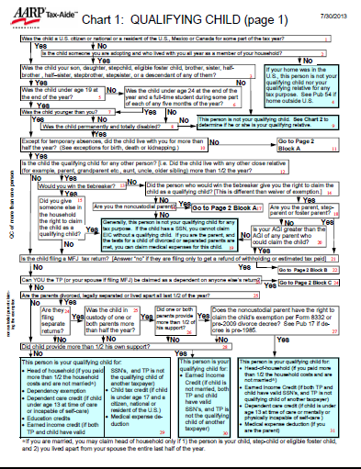
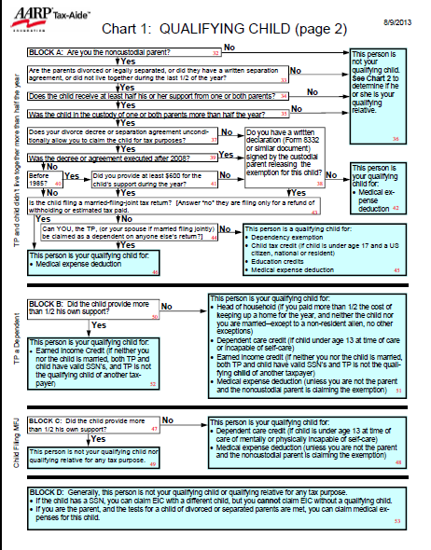
Qualifying Child Chart:
Notes:
Lots of different routes to this credit
It is best to have a copy of the QC/QR Tri-Fold in hand in order to follow the information in these slides.

Slide 9
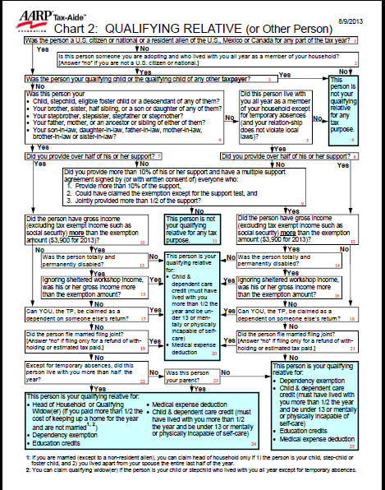
Qualifying Relative Chart

Slide 10
Child of Divorced...Parents
Must live with taxpayer half the year, so credit goes to custodial parent (if he or she paid the expense)

Slide 11
Paid for Care—Not Education
Below kindergarten okay
After school okay if not educational
Day camp okay, overnight camp not
Adult day care okay
In-home care okay
Notes:
Kindergarten used to be included. It was removed a few years ago.
Some in-home care may be used as either medical expense or dependent care—not both.
Wages and employment taxes for household employee is an allowed expense; however, it is out of scope.
Household services that are at least partly for the well-being and protection of a qualifying person are ok. [includes housekeeper, maid, or cook—but not a chauffeur or gardener]
From Instructions to Form 2441:
Care includes the cost of services for the qualifying person's well-being and protection. It does not include the cost of food, lodging, education, clothing, or entertainment.
You can include the cost of care provided outside your home for your dependent under age 13 or any other qualifying person who regularly spends at least 8 hours a day in your home. If the care was provided by a dependent care center, the center must meet all applicable state and local regulations. A dependent care center is a place that provides care for more than six persons (other than persons who live there) and receives a fee, payment, or grant for providing services for any of those persons, even if the center is not run for profit.
You can include amounts paid for items other than the care of your child (such as food and schooling) only if the items are incidental to the care of the child and cannot be separated from the total cost. But do not include the cost of schooling for a child in kindergarten or above. You can include the cost of a day camp, even if it specializes in a particular activity, such as computers or soccer. But do not include any expenses for sending your child to an overnight camp, summer school, or a tutoring program.

Slide 12
Employer-provided Benefit
Must be deducted from taxpayer expenses (taxpayer claims net out of pocket)
TaxSlayer does this automatically for Form W-2 box 10 amount
Amounts in Part II - 2(a) must not total more than net shown
Notes:
These appear on W-2 Box 10 and are included in income on Line 7 until Form 2441 is completed
If benefits were received that are not on Form W-2, enter the amount on TaxSlayer page 2

Slide 13
Who is the Caregiver?
Cannot be spouse or dependent
Cannot be taxpayer’s child who is
under age 19
Cannot be child’s parent (with some exceptions for disabled adults)
Counselor must make reasonable effort to get provider’s name, address and identifying number
Notes:
If you can’t get the EIN, SSN or ITIN for the provider you cannot e-file and must complete an explanation on the back of Form 2441.
If caregiver is your employee, and total payments were more than $2000, then Schedule H for household employees is required, and return is out of scope.

Slide 14
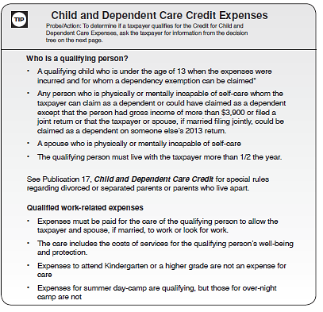
Resource Guide
Pub 4012:
Pages G-3
thru G-5
Notes:
All this info is here. Rules about the care-giver are included in the Decision Tree.

Slide 15
How Much is the Credit?
20% – 35% of amount spent
Percent is based on AGI
Maximum amount spent
  $3,000 for one person
  $6,000 for two or more
  Lesser of taxpayer’s or spouse’s earned income
Notes:
TaxSlayer makes all calculations.

Slide 16
Earned Income Requirement
Taxpayer or spouse can have deemed earned income if a full-time student (at least 5 months) or disabled
  $250 per month ($500 if care is for more than one qualifying person)
  Taxpayer or spouse can have deemed income in a given month (not both)
  Use actual earned income if higher
Notes:
If the taxpayer or spouse is a full-time student (at least 5 months) or is disabled, they are deemed to have earned income for each month of $250 ($500 if more than one qualifying person was cared for)
If taxpayer and spouse are full-time students or disabled in a month, only one can have the deemed earned income
If the student or disabled TP or SP also worked, use the higher of the basic amount or their actual compensation

Slide 17


Entering in TaxSlayer
Pick either of these:
  Type “2441” into:
  Summary/Print 1040 p. 2, click line 49:
  Navigate to:
  > Federal Section
  > Deductions
  > Credits Menu
  > Child Care Credit (Form 2441)

Slide 18
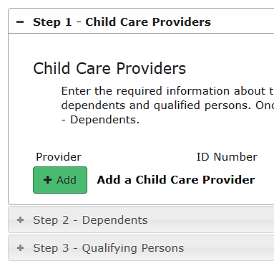
Entering in TaxSlayer
Follow Pub 4012 Tab G-5,
Form 2441 – Credit for Child and Dependent Care Expenses
Notes:
TaxSlayer Note: The 2441 covers expenses paid for child care. The amount paid to the provider(s) of the child care must equal the total expenses of the dependents and any qualified person not listed on the return as a dependent. If the totals do not balance out to a difference of $0, then there is a risk of rejection of the return.

Slide 19
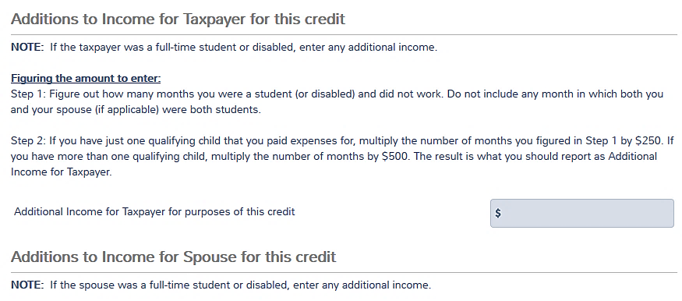
Deemed Earned Income in TaxSlayer
Compute deemed earned income for each and enter in TaxSlayer
Notes:
Compute the amount and enter
If not MFJ, TaxSlayer will ask only for TP (not spouse)

Slide 20

Quality Review
Verify that care was for taxpayer to work or look for work
Verify that deemed income for disabled or student spouse was entered correctly

Slide 21
Quiz 1
Mary and Tom file MFJ. Mary is a stay-at-home mom. When she needed to travel to take care of her own parents, Mary and Tom paid for day care for their kids. Can they claim the dependent care credit for this expense?
No – payment was not so Mary could work or look for work.
Notes:
No, the payment was not so Mary could work or look for work.

Slide 22
Quiz 2
Maria’s husband Jose has dementia and cannot be left at home alone. She takes him to an adult day care at the local hospital each day on her way to work. Can they claim the dependent care credit even though Jose does not work?
Yes – complete TaxSlayer Form 2441 Step 3 - Qualifying Persons for a disabled spouse.
Notes:
Yes, complete the bottom of Form 2441 for a disabled spouse.

Slide 23
Quiz 3
Amanda lives with her mother. As part of the divorce decree, her father Jack agreed to pay for Amanda’s day care while her mother works. Amanda’s mother has signed Form 8332 so that Jack can claim Amanda’s exemption. Who can claim the dependent care credit?
No one. Amanda did not live with Jack for six months, so he cannot claim it; and Amanda’s mother did not pay it, so she cannot claim it.
Notes:
No one. Amanda did not live with Jack for 6 months, so he cannot claim it; and Amanda’s mother did not pay it, so she cannot claim it.

Slide 24
Child and Dependent Care
Questions?
Comments?

